Slide 1
24MAT120
S2 P & M

Slide 2
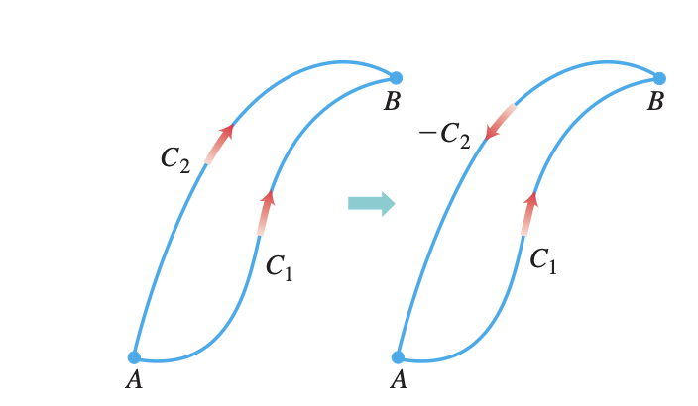
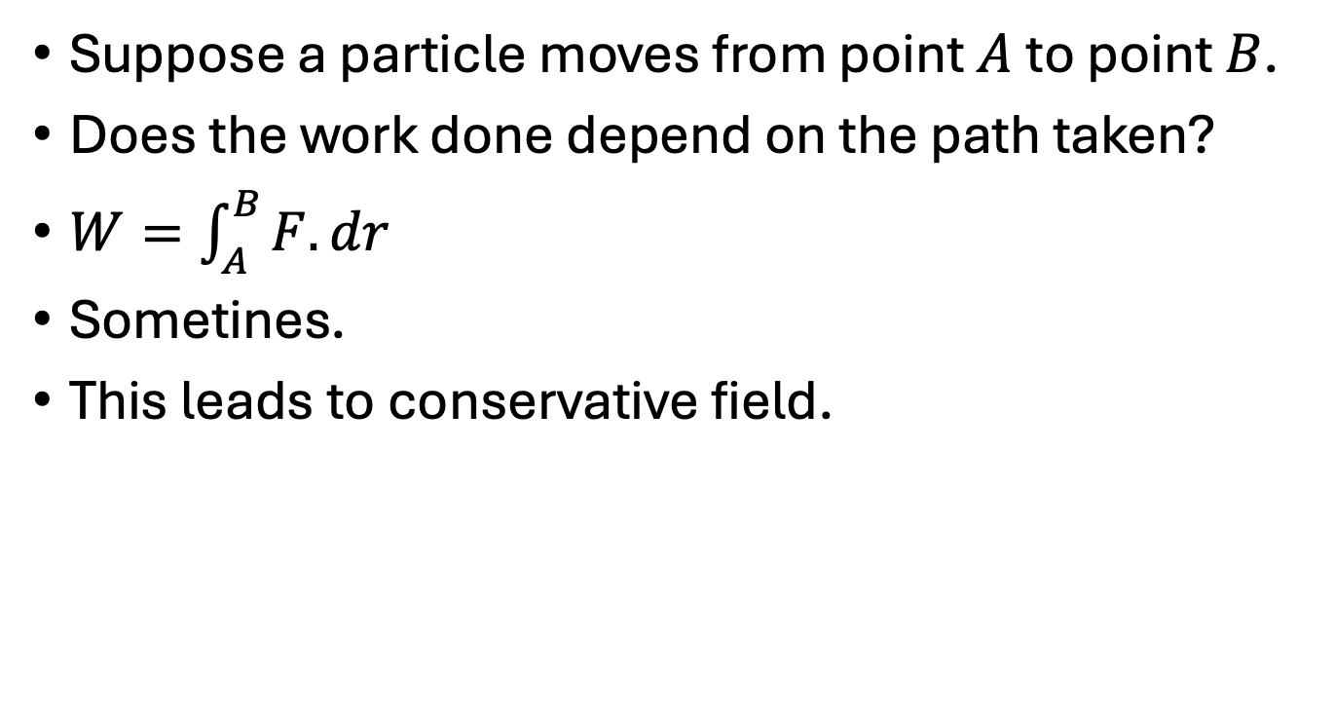
Conservative Field
Suppose a particle moves from point $A$to point $B$.
Does the work done depend on the path taken?
$W=\int_{A}^{B}{F.dr}$
Sometines.
This leads to conservative field.

Slide 3
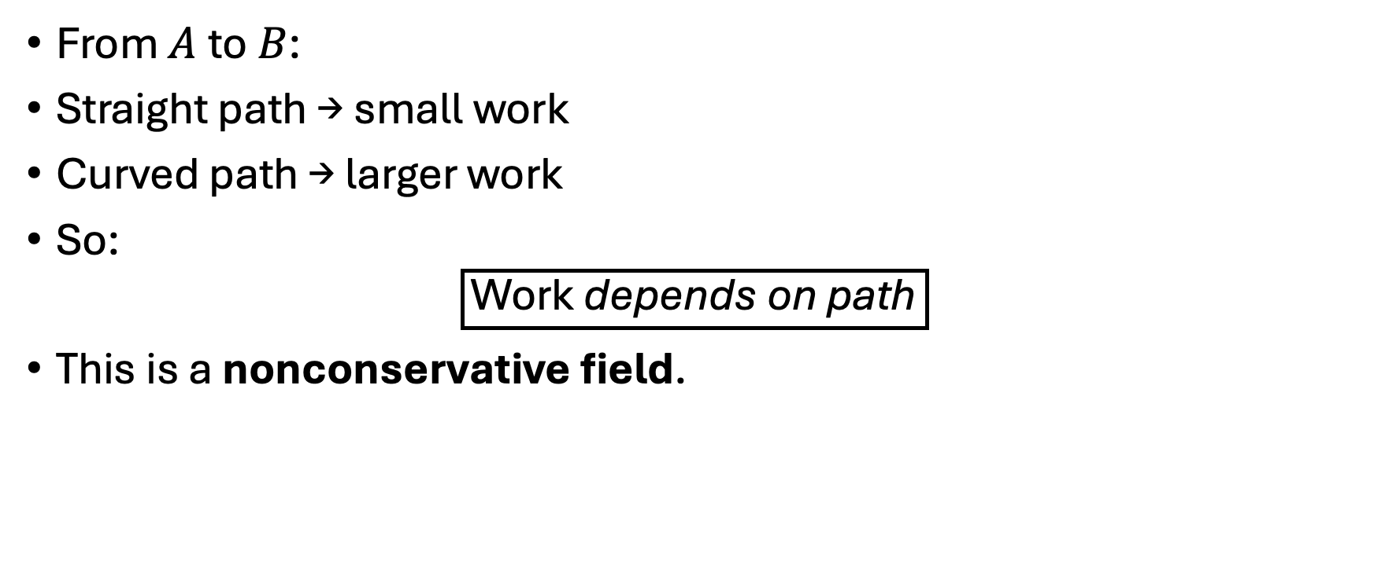
Frictional Work Field Conservative?
From $A$to $B$:
Straight path → small work
Curved path → larger work
So:
$$\boxed{\text{Work} \text{depends} \text{on} \text{path}}$$
This is a nonconservative field.

Slide 4
Gravitational Work Field Conservative?
Whether you lift vertically, move along a ramp, follow a curved path, the work against gravity is mgΔh same in every case.
Gravity depends only on position, not on how you traveled.
So: Work depends only on endpoints ​
This is a conservative field.

Slide 5
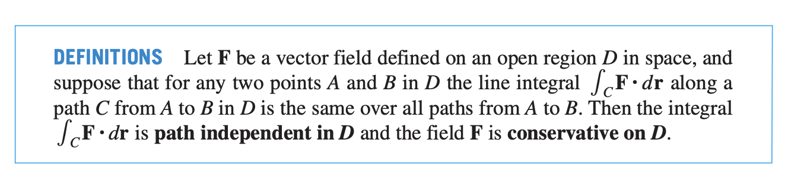

Slide 6
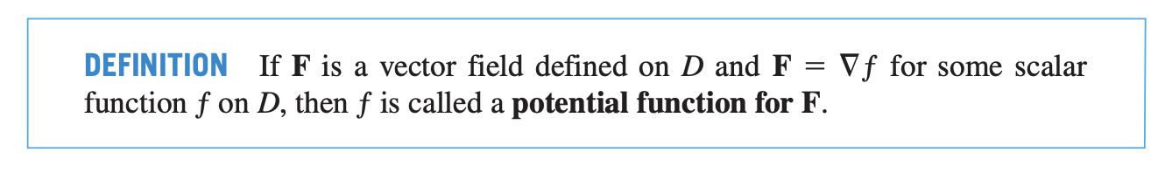

Slide 7
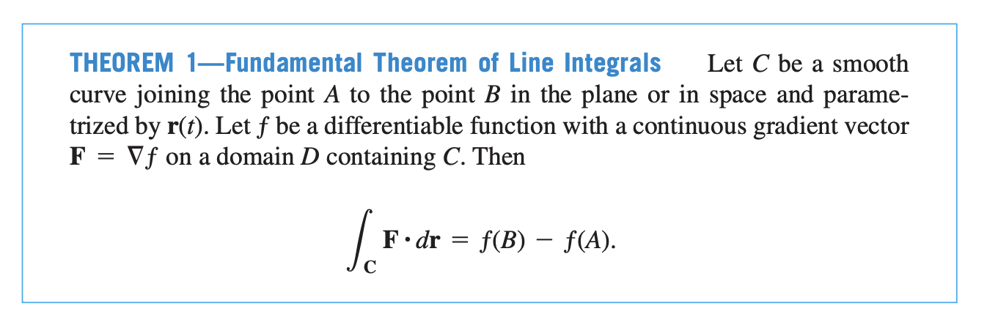

Slide 8
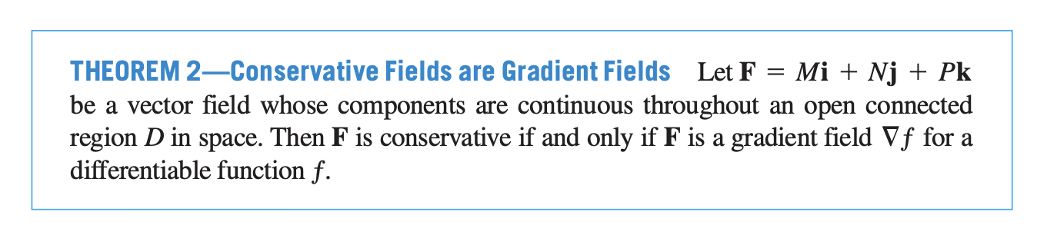
Conservative fields are generated by potential energy functions, so energy is conserved and work depends only on endpoints.

Slide 9
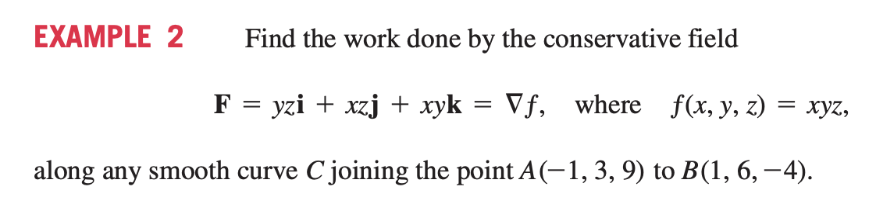

Slide 10
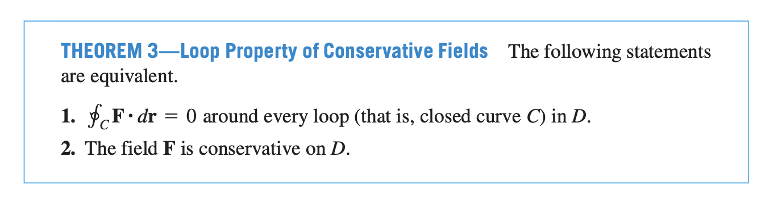

Slide 11
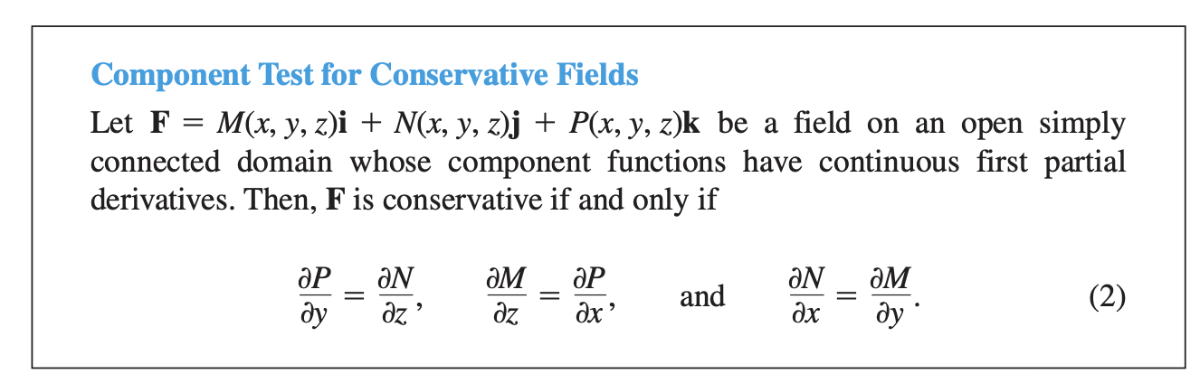
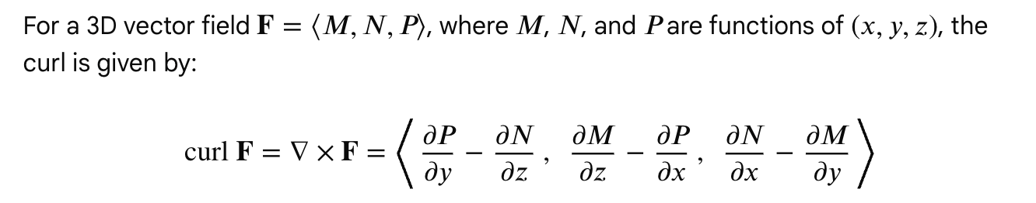

Slide 12
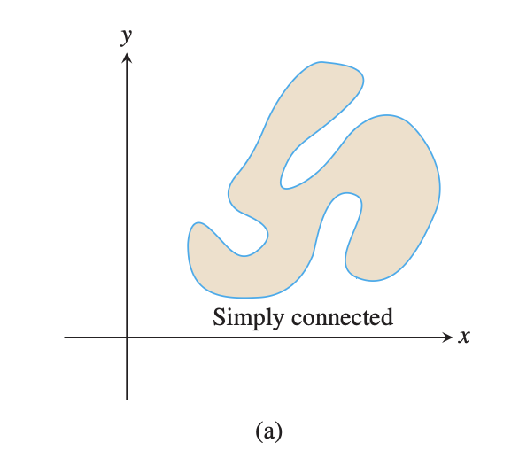
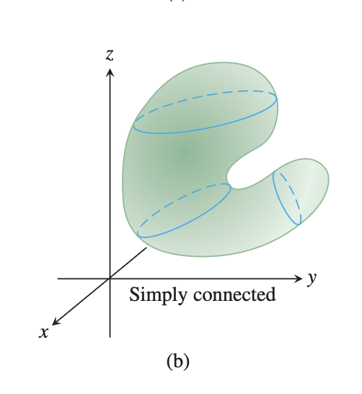
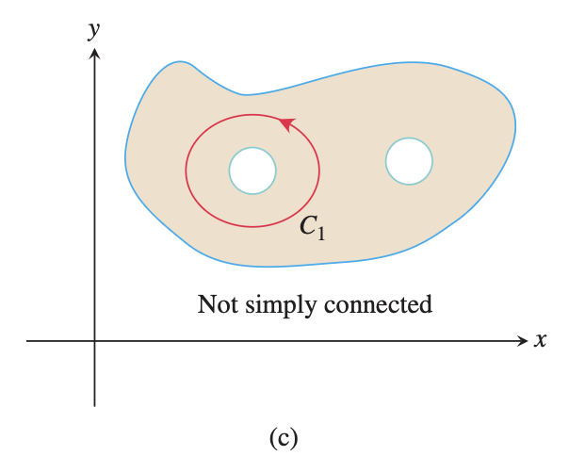
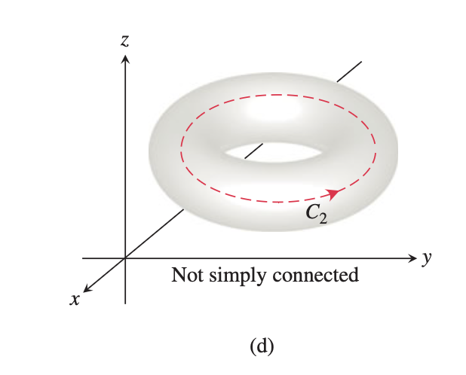

Slide 13
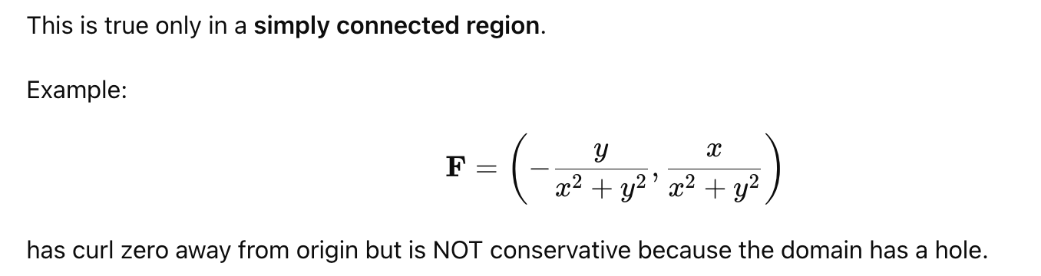

Slide 15
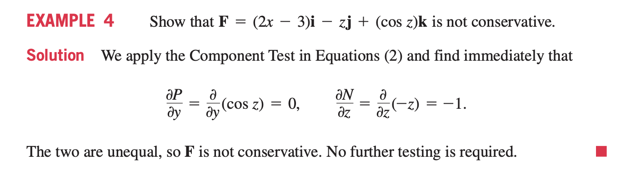

Slide 16
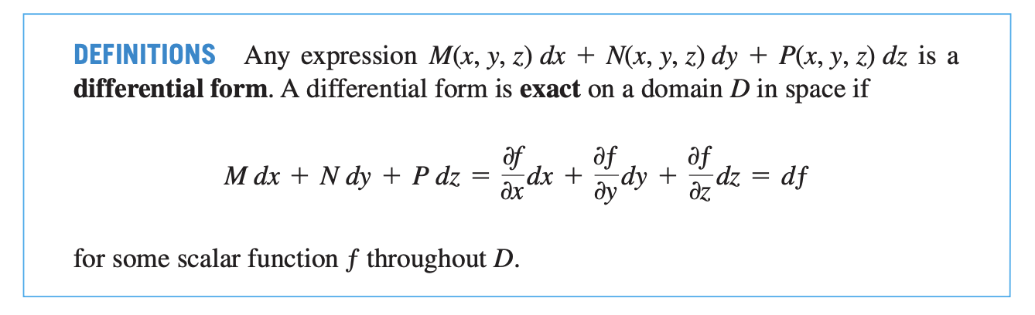

Slide 17
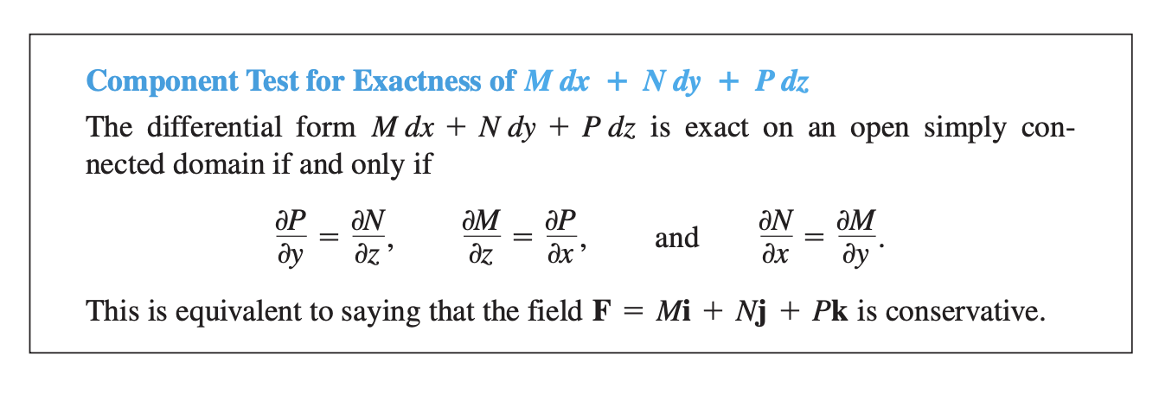

Slide 18
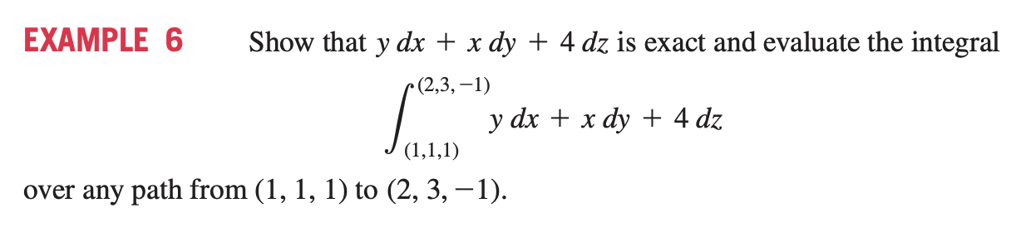

Slide 19
